Slide 1

ETHICS

Slide 2
Ethics
Computer ethics is a system of moral standards or values used as a guideline for computer users.
Eg:- Google has released what is effectively a rulebook for how the company will apply AI technology
The seven principles include making sure that AI is applied to applications that are socially beneficial, safe and won't create unfair bias.

Slide 3
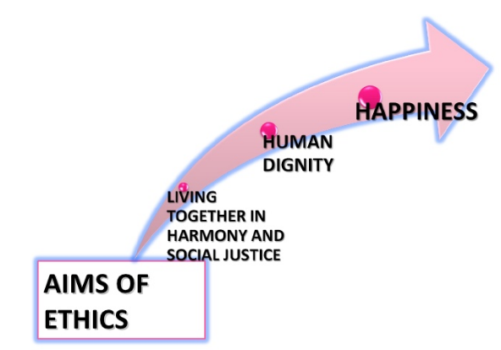


Slide 4
Legal Issues
A legal issue can be any question of law that arises from a particular set of facts.
To prevent the misuse of computers.
Eg:- Copying and Legal Issues
make sure your research and development teams thoroughly research the patents and copyrights of your current product, to avoid a messy legal battle should you step on a competitor's toes.

Slide 5
Learning Outcomes
By the end of this course students will be able to:
To understand ethical environment of work.
Understand about the latest trends and current issues in information technology.
Describe the various types of funding and schemes for start up business in IT sector.
Comply with various cyber laws and related semantics for deploying security mechanisms in IT industry.
Understand various types of legal, ethical and professional issues in Information Security.
Understand the concept of intellectual properties.

Slide 6
Learning Outcomes
Reflectively judge the morality of behaviours involving the use of computers
Defend or attack a wide range of moral and/or legal standpoints involving the use of computers.
Recognize and act upon legal issues and constraints in computing

Slide 7
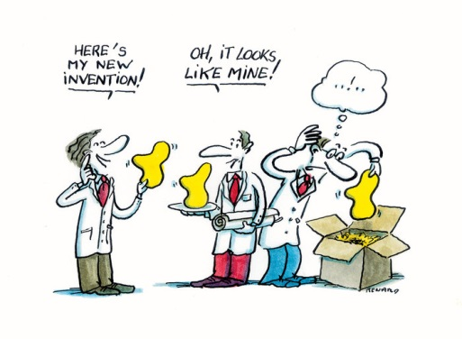
NEED

Slide 8


How we can?
For this question you need to listen

Slide 9

ETHICS
UNIT 1

Slide 10
ETHICS
Ethics is the field of study that is concerned with questions of value, i.e., judgments about what human behavior is "good" or "bad" in any given situation.
Ethics are the standards, values, morals, principles, etc., which are used to base one's decisions or actions on; often there is no clear "right" or "wrong" answer.

Slide 11
ETHICS
Ethics is a set of belief about right and wrong behaviour.
For example, how would you decide which person should live or die?

Slide 13
Cisco “World’s Most Ethical Company”
1. It believes “A strong commitment to ethics is critical to our long-term success as a company. Any success that is not achieved ethically is no success at all”.
2. Cisco conducts numerous programs aimed at fulfilling what it sees as its corporate social responsibilities, Donations, manages energy and greenhouse emission generated by its operations.
3. Cisco Chairman and CEO advocates Ethical Behaviour It communicates its Code of Conduct to suppliers, monitors their compliance, and helps them improve performance.
Notes:
Cisco is a U.S.-based multinational corporation that designs, sells, and manufactures networking equipment. The company’s operations generated $46 billion in sales and $8 billion in net income for fiscal year 2012.1 Cisco has been named a “World’s Most Ethical Company” honoree by the Ethisphere Institute for five consecutive years (2008–2012).2 Its Chairman and CEO John Chambers states: “A strong commitment to ethics is critical to our long-term success as a company. The message for each employee is clear: Any success that is not achieved ethically is no success at all. At Cisco, we hold ourselves to the highest ethical standards, and we will not tolerate anything less.”3 Cisco conducts numerous programs aimed at fulfilling what it sees as its corporate social responsibilities. For instance, the company provides ethics training to its over 70,000 employees, and it prides itself on providing employee benefits that foster a good work-life balance. Cisco employees are also encouraged to donate money and volunteer hours to non-profit organizations around the world. Cisco manages energy and greenhouse emission generated by its operations. The company demands the same high standards from its more than 600 supply chain partners in regard to ethics, labour practices, health and safety, and the environment; it communicates its Code of Conduct to suppliers, monitors their compliance, and helps them improve performance. Cisco collaborates with industry groups to raise standards and build sustainability capabilities throughout its supply chain. The company uses its core expertise in networking technology to improve both the delivery and quality of education as well as to improve health care. It also intervenes to help meet critical human needs in times of disaster by providing access to food, potable water, shelter, and other forms of relief. For example, in 2012, Cisco employees pledged $1.25 million and 12,500 volunteer hours to the Global Hunger Relief Program. Both the Cisco Foundation and Cisco Chairman Emeritus John Morgridge match employee donations, thus tripling the potential donation

Slide 14
Answer the question
What does it mean for an individual to act in an ethical manner? What does it mean for an organization to act ethically?
How should an organization balance its resources between pursuing its primary mission for existence and striving to meet social responsibility goals?

Slide 15
What is difference between moral, ethics and law?

Slide 16
Ethics and Morality
Ethics refers to standards of conduct, standards that indicate how one should behave based on moral duties and virtues, which themselves are derived from principles of right and wrong.

Slide 17
Moral Relativism
Values are determined by the society we grow up in, and there are no universal values. Moral values are simply customs or conventions that vary from culture to culture.

Slide 18

Describe the characteristics of justice
Notes:
Answer: Treating people fairly and equally.

Slide 19
Why Law is Necessary
Law is the system of rules of conduct established by the government of a society to maintain stability and justice.
Law defines the legal rights and duties of the people and provides the means of enforcing these rights and duties.

Slide 20
Ethics and Legal Conflicts
Because law is made by people, it is imperfect.
Legislators and judges bring their own personal opinions on ethics to the lawmaking process.
As a result, ethics and law will sometimes conflict.

Slide 21
Define Law
Notes:
Law is the rules of conduct established by the government of a society to maintain stability and justice.

Slide 22
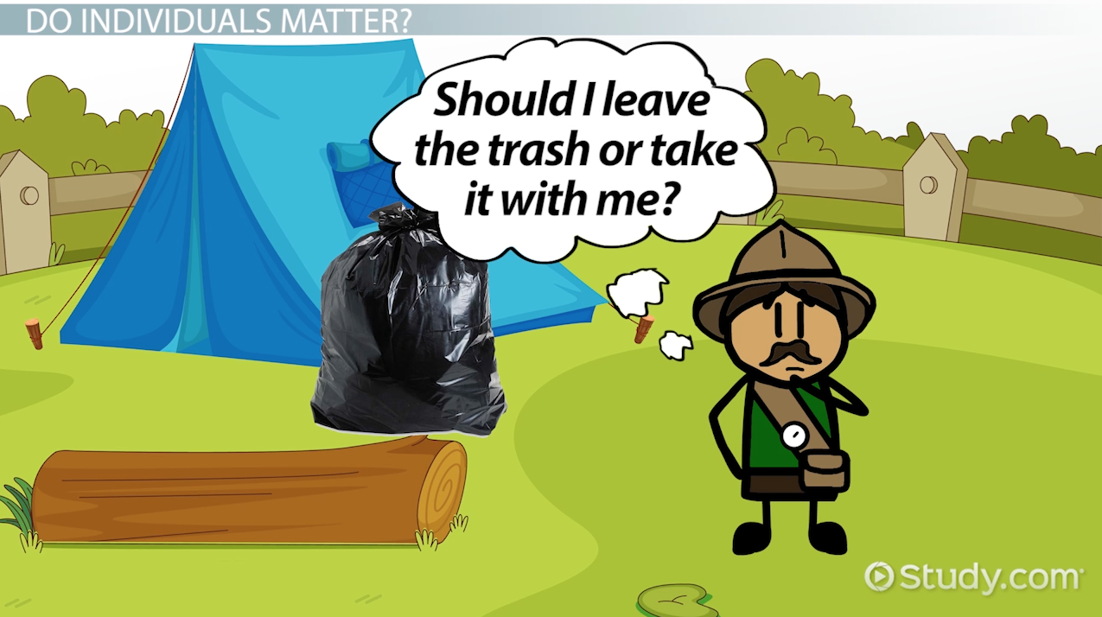

Slide 23
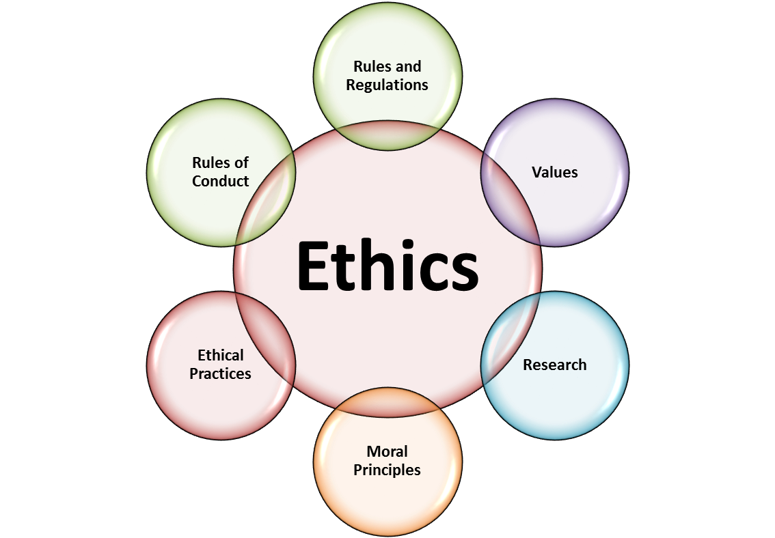
Ethics

Slide 24

Ethics

Slide 25
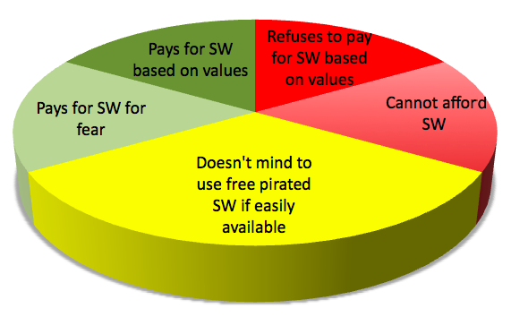
Why Piracy happens?

Slide 26
IMPORTANCE OF
INTEGRITY
Integrity means following your moral or ethical convictions and doing the right thing in all circumstances, even if no one is watching you. Having integrity means you are true to yourself and would do nothing that demeans or dishonour you..
Example:- Temptation of picking money or cell phone from the bench

Slide 27
ETHICS IN THE BUSINESS WORLD
Why promoting Good business ethics is important:-
To gain the goodwill of the community
To create an organization that operates consistently.
To produce good business
To protect the organization and its employees from legal action
To avoid unfavourable publicity.
Example :-the Peanut Corporation of America allegedly shipped tainted products from its plant in Georgia, which led to a salmonella outbreak in 2008 that killed at least eight people and sickened over 550 people in 43 states.

Slide 28
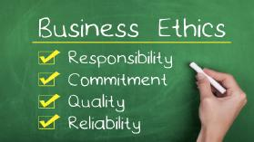

Slide 29
CSR
Corporate social responsibility (CSR) is the concept that an organization should act ethically by taking responsibility for the impact of its actions on the environment, the community, and the welfare of its employees

Slide 30
TO PRODUCE GOOD BUSINESS
Companies that produce safe and effective products avoid costly lawsuits.
The recall of the weight loss drug Fen-Phen cost its maker, Wyeth-Ayerst Laboratories, almost $14 billion in awards to victims, many of whom developed serious health problems as a result of taking the drug.
Example :- MAGGI

Slide 31
Avoiding Unfavourable Publicity
In 2012, Google agreed to pay a fine of $22.5 million to end an FTC investigation into allegations that the firm utilized cookies and bypassed privacy settings to track the online habits of people using Apple’s Safari browser..
Why did Google agree to pay?

Slide 32
Lecture 2
Unit 1

Slide 33
Improving Corporate Ethics
Assume one scenario, you want to start a company (any company) what type of rules you will going to make for your employee.

Slide 34
Improving Corporate Ethics
Ethics Resource Centre found
Attended Ethical workshop | NOT attended ethical workshop
86% of them are perceiving strong ethical culture | 25% of them are perceive a culture that promote integrity

Slide 35
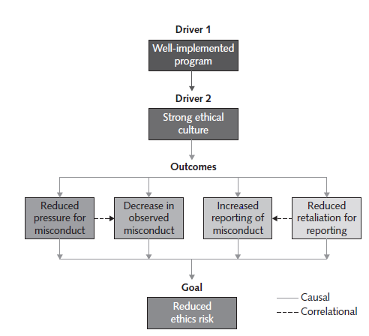

Slide 36
Characteristics of a Successful Ethics Program
Employees are willing to seek advice about ethics issues.
• Employees feel prepared to handle situations that could lead to misconduct.
• Employees are rewarded for ethical behaviour.
• The organization does not reward success obtained through questionable means.
• Employees feel positively about their company.

Slide 37
How can we improve business ethics ?
Appointing a Corporate Ethics Officer
A corporate ethics officer (also called a corporate compliance officer) provides an organization with vision and leadership in the area of business conduct.
The corporate ethics officer should be a well-respected, senior-level manager who reports directly to the CEO.
Ethics officers come from diverse backgrounds, such as legal staff, human resources, finance, auditing, security, or line operations.

Slide 38
- Creating an ethical work environment
- Ethical decision making
- Ethics in information technology
UNIT 1

Slide 39
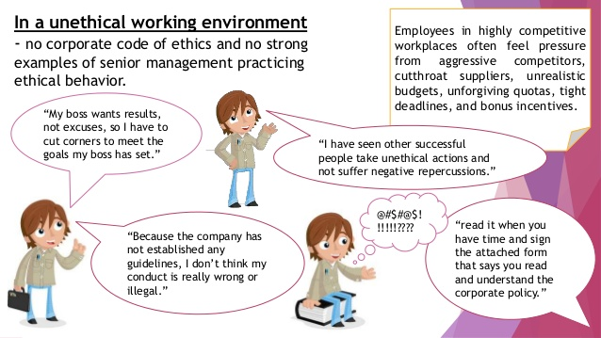
Creating an Ethical Work Environment
Notes:
https://www.youtube.com/watch?v=b_n6i1ug0tQ

Slide 40

DECISION

Slide 41
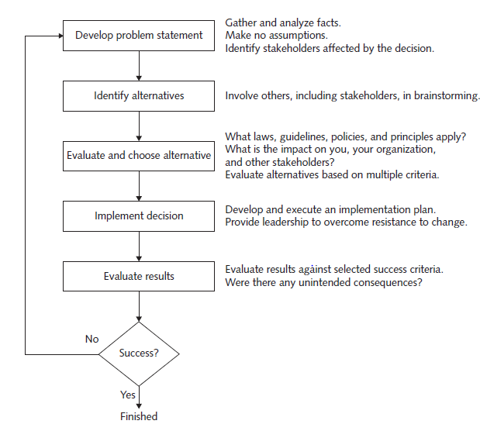
INCLUDING ETHICAL CONSIDERATIONS IN DECISION MAKING

Slide 42
EVALUATE THE RESULTS
After the solution to the problem has been implemented, monitor the results to see if the desired effect was achieved, and observe its impact on the organization and the various stakeholders.
  Were the success criteria fully met?
  Were there any unintended consequences?

Slide 43
ETH ICS IN INFORMATION TECHNOLOGY
Here are some examples that raise public concern about the ethical use of information technology:
Millions of people have downloaded music and movies at no charge and in apparent violation of copyright laws at tremendous expense to the owners of those copyrights.

Slide 44
Organizations contact millions of people worldwide through unsolicited email (spam) as an extremely low-cost marketing approach.
Hackers break into databases of financial and retail institutions to steal customer information, then use it to commit identity theft—opening new accounts and charging purchases to unsuspecting victims.

Slide 45
Students around the world have been caught downloading material from the Web and plagiarizing content for their term papers.
Web sites plant cookies or spyware on visitors’ hard drives to track their online purchases and activities.

Slide 46
ETHICS FOR IT WORKERS
&
IT USERS
Notes:
https://www.youtube.com/watch?v=u5sjQu3ue3c

Slide 47
Profession
A profession is a calling that requires specialized knowledge and often long and intensive academic preparation.
Professional ?

Slide 48


Professionals

Slide 49
Professional Employee
The United States Code of federal regulations defines a “professional employee” as one who is engaged in the performance of work:
Requiring knowledge of an advanced type in a field of science or learning customarily acquired by a prolonged course of specialized intellectual instruction and study in an institution of higher learning.
Requiring the consistent exercise of discretion and judgment in its performance.

Slide 50


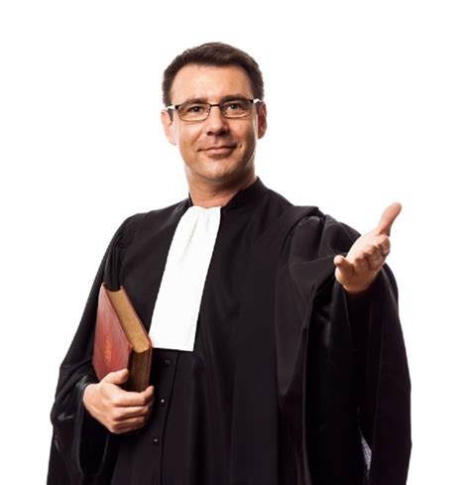
Professionals such as doctors, lawyers, and accountants require advanced training and experience; they must exercise discretion and judgment in the course of their work.

Slide 51
Are IT Workers Professionals?
IT Professional can be:
  Marketing analysts, financial consultants, and IT specialists such as mobile application developers, software engineers, systems analysts, and network administrators.
From a legal perspective, IT workers are not recognized as professionals because they are not licensed by the state or federal government.
Notes:
Morally yes ethically no

Slide 52
IT workers often have the skills and knowledge to abuse systems and data or to enable others to do so.
Software piracy is an area in which IT workers may be tempted to violate laws and policies. Although end users often get the blame when it comes to using illegal copies of commercial software
Notes:
https://www.youtube.com/watch?v=n_ASTEeCzJI

Slide 53
Common Ethical Issues for IT Users
1)Software Piracy:
Software Piracy in a corporate setting can sometimes be directly traceable to IT professionals—they might allow it to happen, or they might actively engage in it.
Sometimes IT users are the ones who commit software piracy. A common violation occurs when employees copy software from their work computers for use at home. When confronted, the IT user’s argument might be: “I bought a home computer partly so I could take work home and be more productive; therefore, I need the same software on my home computer as I have at work.”

Slide 54
2) Inappropriate Use of Computing Resources:
Some employees use their computers to surf popular Web sites that have nothing to do with their jobs, participate in chat rooms and play computer games. These activities eat away at worker productivity and waste time.
Example :- Executive Director of the Pentagon’s Missile Defence Agency issued a memo to its 8,000 employees warning them to stop using their work computers to access Internet objectionable sites. One concern of government officials is that these sites are infected with computer viruses and other malware; criminals and foreign intelligence agencies often use such sites as a means to gain access to government and corporate computer networks. For example, a foreign agent can embed malware capable of stealing data or opening computer communications ports whenever certain photos or videos are downloaded to a computer

Slide 55
3) Inappropriate Sharing of Information:
Every organization stores vast amounts of information that can be classified as either private or confidential. Private data describes individual employees—for example, their salary information, attendance data, health records, and performance ratings. Private data also includes information about customers—credit card information, telephone number, home address, and so on.
Notes:
In late 2010, hundreds of thousands of leaked State Department documents were posted on the WikiLeaks Web site. As of this writing, it appears that the source of the leaks was a low-level IT user (an Army private) with access to confidential documents. The documents revealed details of behind-the-scenes international diplomacy, often divulging candid comments from world leaders and providing particulars of U.S. tactics in Afghanistan,
Iran, and North Korea

Slide 56
Trade secret
A trade secret is information, generally unknown to the public, that a company has taken strong measures to keep confidential. It represents something of economic value that has required effort or cost to develop and that has some degree of uniqueness or novelty.
Example
Colonel’s secret recipe of 11 herbs and spices used to make the original KFC chicken, the formula for Coke, and Intel’s manufacturing process for the i7 quad core processing chip.
Employers worry that employees may reveal these secrets to competitors, especially if they leave the company. As a result, companies often require employees to sign confidentiality agreements and promise not to reveal the company’s trade secrets.
Notes:
https://www.youtube.com/watch?v=Wka2Bkiq3Qk

Slide 57
Installing and Maintaining a Corporate Firewall:
A firewall can be configured to serve as an effective deterrent to unauthorized Web surfing by blocking access to specific objectionable Web sites

Slide 58
Certification and licensing
Certification indicates that a professional possesses a particular set of skills, knowledge, or abilities, in the opinion of the certifying organization.
Licensing applies only to people and is required by law, certification can also apply to products (e.g., the Wi-Fi CERTIFIED logo assures that the product has met rigorous interoperability testing to ensure that it will work with other Wi-Fi-certified products) and is generally voluntary.
IT-related certifications may or may not include a requirement to adhere to a code of ethics, whereas such a requirement is standard with licensing.

